Slide 1

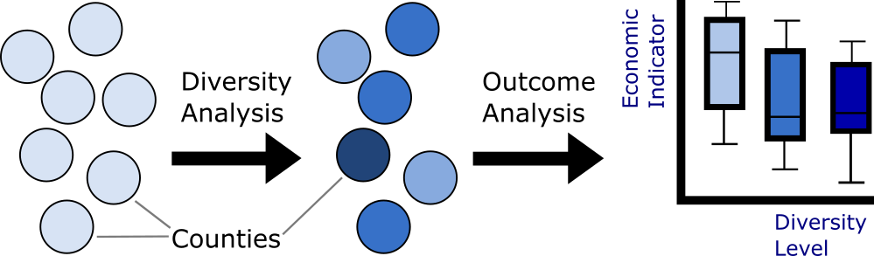
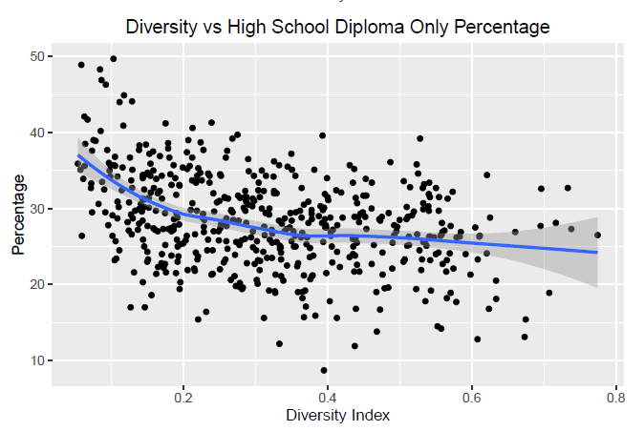
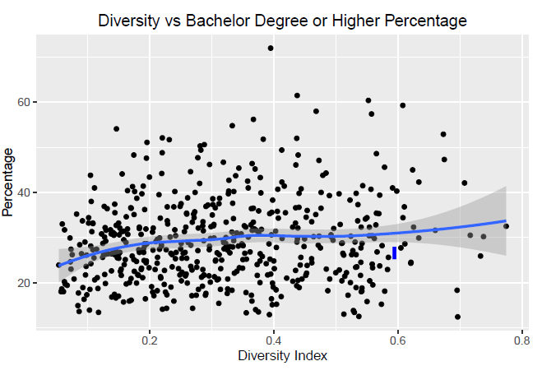

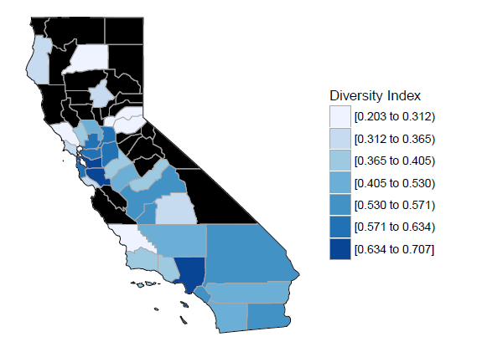
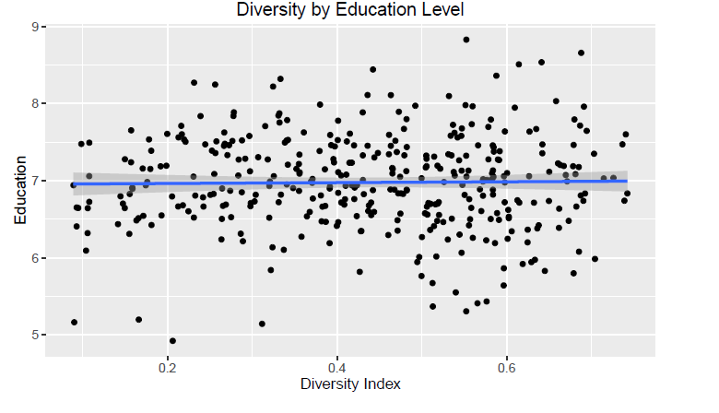
Effects of County-Level Diversity on Educational, Economic,
And Health-Related Outcomes
Ken Groszman, Jack Petersen, Bing Xu
Final Project for STAT 405– R for Data Science, Dr. Roberto Bertolusso
Department of Statistics, Rice University,
Introduction
Educational Outcomes
Health-Related Outcomes
Motivation:
In today’s society, it is common to hear the government, businesses, and members of our community touting the benefits of diversity [1]
Indeed, diversity provides micro-scale benefits in certain organizations (new perspectives, increased productivity, expanded worldview, etc.) [2]
We seek to examine macro-level effects of county-level diversity on a variety of downstream indicators of success: education, economics, and health
Workflow:
Here, we look for correlations between county diversity and educational outcomes
Data:
Results and Interpretation: (INCLUDE SUMMARY STATISTIC)
More diverse counties have a higher percentage of people reaching the highest education level, and that less diverse counties have the most number of people with low educational attainment (high school only)
Sjkmr
Re
Rejrekmerkname
a
Variable | Description | Source
Educational Attainment | Code corresponding to highest level of education achieved: no high school, high school diploma, Associate’s degree, Bachelor’s degree, | [4]
Calculation of Diversity Index
Probably also crappy results
Description of Methods:
Each county j is assigned a diversity index value d_{j} based on the race breakdown of its population
The diversity index is calculated according to the following formula, where x_{ij} is the proportion of race i in county j:
A county with the highest possible d_{j} has its population spread exactly evenly across the 8 races, whereas the lowest possible score has its entire population as one of the groups (i.e. 100% white, 0% everything else)
Data:
Data is pulled from IPUMS (Integrated Public Use Microdata Series), which is census-level data for selected counties in the USA
Results: (do we want to add grouping counties into categories??)
US County Diversity Choropleth County Diversity Histogram
Economic Outcomes
Future Plans
If this gets actually good results, we should put it on top!
Stuff about doing further research
Variable | Description | Source
Geographic Location | County location of record, given by state and county FIPS (Federal Info. Processing Standard ) code | [3]
Race | Numerical code corresponding to race of individual: white, black, American Indian, Chinese, Japanese, Pacific Islander, other, 2+ races | [3]
Add these puppies
Acknowledgements
Thi
References
Links to all of our great data, IPUMS, etc.

